Slide 1
Learning Objective
I will be able to define the geometric finite series
Success Criteria
At the end of the lesson, I will be able to:
define the concept of a finite sum;
determine geometric sums using a recursive process;
derive the finite geometric sum (series) formula and use it to calculate the sum of n terms;
find the common ratio, first term or number of terms, given sufficient information;
apply finite geometric sums to applied problems involving exponential growth and decay.

Slide 2
Geometric Series
Concept Development
The sum of a geometric sequence is called a geometric series.
With geometric series, we can either calculate a finite sum or an infinite sum. This idea of finite vs. infinite sums is redundant in arithmetic series, because all infinite sums in arithmetic series are divergent, whereas there exist infinite sums in geometric series that are convergent.

Slide 3

Deriving the general rule for a geometric series
Deriving the General Rule for Geometric Series
For a general geometric series with the first term, $a$, and common ratio, $r$.
$$S_{n}=a+ar+ar^{2}+ar^{3}+…+ar^{n−2}+ar^{n−1} [1]$$
Multiply both sides by $r$.
$${rS}_{n}= ar+ar^{2}+ar^{3}+…+ar^{n−1}+ar^{n} [2]$$
[1] – [2]
$$S_{n}−rS_{n}=a−ar^{n}$$
$$S_{n}(1−r)=a+ar^{n}$$

Slide 4

Deriving the General Rule for Geometric Series
For a general geometric series with the first term, $a$, and common ratio, $r$:
$$S_{n}=\frac{a(1−r^{n})}{1−r} r≠1$$
If $r>1$ or $r<−1$, i.e. $|r|>1$, then the formula can be rearranged in the following form:
$$S_{n}=\frac{a(r^{n}−1)}{r−1} r≠1$$

Slide 5
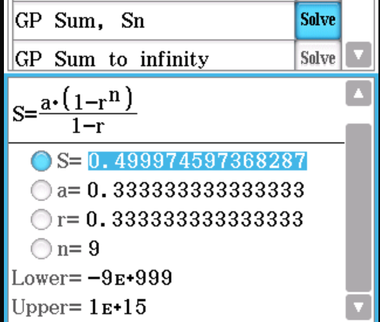

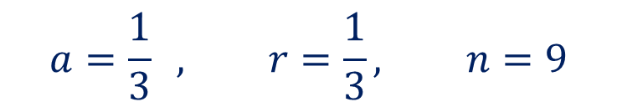
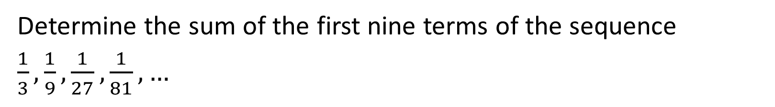
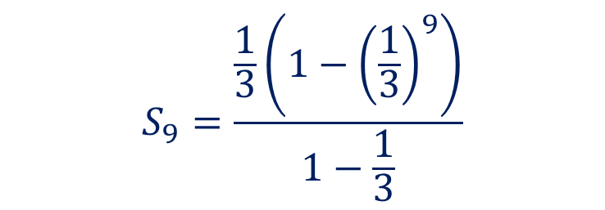
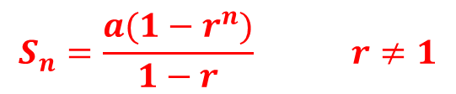
Guided Practice
$$S_{n}=\frac{a(1−r^{n})}{1−r} r≠1$$
Determine the sum of the first nine terms of the sequence
$\frac{1}{3},\frac{1}{9},\frac{1}{27},\frac{1}{81}, …$
$$a=\frac{1}{3} , r=\frac{1}{3}, n=9$$
$$S_{9}=\frac{\frac{1}{3}\left(1−{\left(\frac{1}{3}\right)}^{9}\right)}{1−\frac{1}{3}}$$
$$S_{9}≈0.499975$$

Slide 6
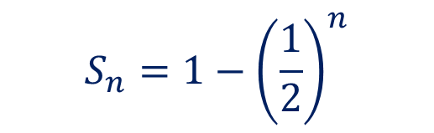


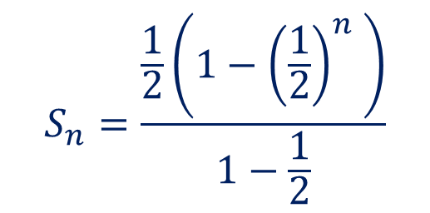
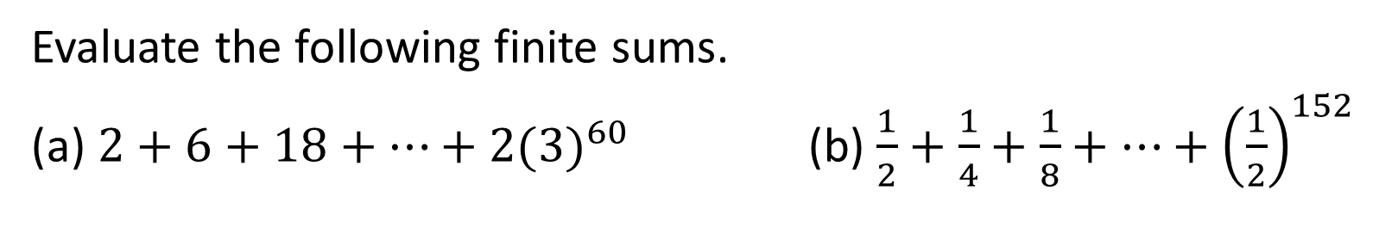




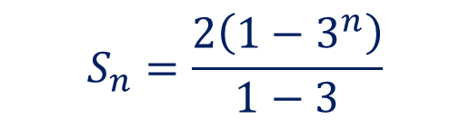
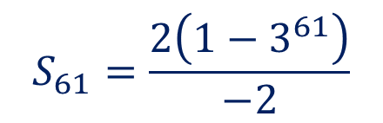
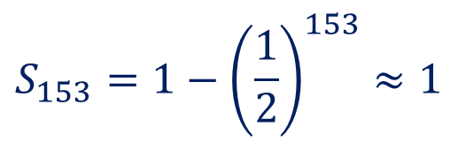
Guided Practice
$$S_{n}=\frac{a(1−r^{n})}{1−r} r≠1$$
Evaluate the following finite sums.
(a) $2+6+18+…+2{(3)}^{60}$ (b) $\frac{1}{2}+\frac{1}{4}+\frac{1}{8}+…+{\left(\frac{1}{2}\right)}^{152}$
$$a=2 , r=\frac{6}{2}=3$$
$$a=\frac{1}{2} , r=\frac{1}{2}$$
$$S_{n}=\frac{2\left(1−3^{n}\right)}{1−3}$$
$$S_{n}=\frac{\frac{1}{2}\left(1−{\left(\frac{1}{2}\right)}^{n} \right)}{1−\frac{1}{2}}$$
$$n=?$$
$$n=61$$
$$S_{61}=\frac{2\left(1−3^{61}\right)}{−2}$$
$$S_{n}=1−{\left(\frac{1}{2}\right)}^{n}$$
$$S_{61}=1.27×{10}^{29}$$
$$S_{153}=1−{\left(\frac{1}{2}\right)}^{153}≈1$$

Slide 7
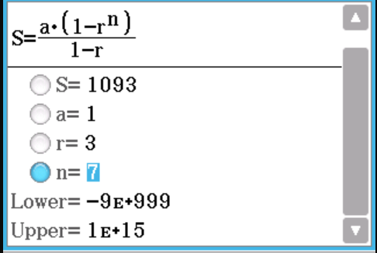



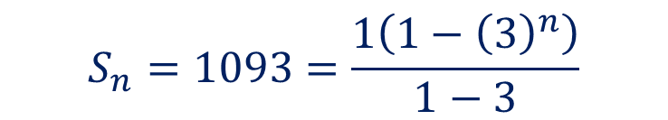
Guided Practice
$$S_{n}=\frac{a(1−r^{n})}{1−r} r≠1$$
For the geometric sequence $1, 3, 9, …$ find how many terms must be added together to obtain a sum of 1093.
$$a=1 , r=3, n=?$$
$$S_{n}=1093=\frac{1\left(1−{\left(3\right)}^{n}\right)}{1−3}$$
$$n=7$$

Slide 8



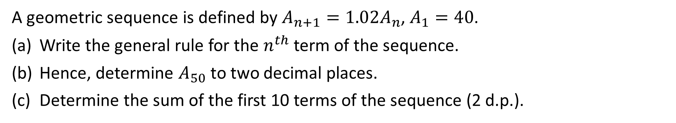


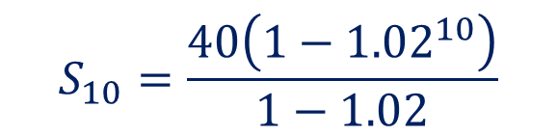

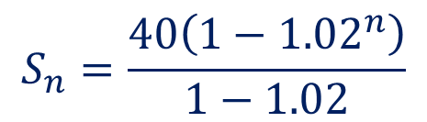
Guided Practice
$$S_{n}=\frac{a(1−r^{n})}{1−r} r≠1$$
A geometric sequence is defined by $A_{n+1}=1.02A_{n}$, $A_{1}=40$.
Write the general rule for the $n^{th}$ term of the sequence.
Hence, determine $A_{50}$ to two decimal places.
Determine the sum of the first 10 terms of the sequence (2 d.p.).
$$a=40 , r=1.02$$
$$A_{n}=a∙r^{n−1}$$
$$A_{n}=40∙{1.02}^{n−1}$$
$$A_{50}=40∙{1.02}^{50−1}$$
$$A_{50}=105.55$$
$$S_{n}=\frac{40\left(1−{1.02}^{n}\right)}{1−1.02}$$
$$S_{10}=\frac{40\left(1−{1.02}^{10}\right)}{1−1.02}$$
$$S_{10}=437.99$$

Slide 9









Guided Practice
$$S_{n}=\frac{a(1−r^{n})}{1−r} r≠1$$
A certain bacterium propagates itself by subdividing, according to the rule:
$$B_{n}=\frac{4^{n+1}}{2}$$
Where $B_{n}$ represents the number of bacteria after 𝑛 subdivisions.
Determine the total number of bacteria after 25 subdivisions. Answer in scientific notation to 4 significant figures.
$$B_{n}=\frac{1}{2}(4^{n+1})$$
$$S_{n}=\frac{8\left(1−4^{n}\right)}{1−4}$$
$$B_{n}=\frac{1}{2}(4×4^{n})$$
$$S_{25}=\frac{8\left(1−4^{25}\right)}{1−4}$$
$$B_{n}=\frac{1}{2}(4×4×4^{n−1})$$
$$S_{25}=3.002×{10}^{15}$$
$$B_{n}=8×4^{n−1}$$
$$a=8, r=4$$

Slide 10
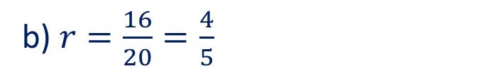
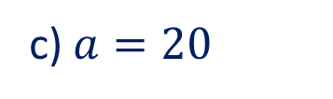
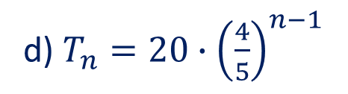
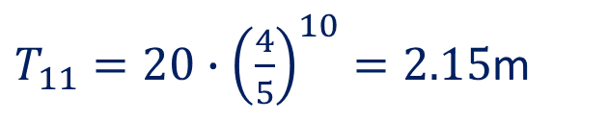


Guided Practice
$$S_{n}=\frac{a(1−r^{n})}{1−r} r≠1$$
A ball is dropped from a height of 20 metres and it rebounds to a height of 16 metres. Every bounce, it continues to rebound to the same proportion of its previous height.
(a) Draw a diagram to represent this situation.
(b) Determine $r$ (decimal) the proportion of the previous height reached after every bounce.
(c) Write a rule for the height of the ball $H_{n}$ after n bounces.
(d) Find the height reached after the 10th bounce.
(e) Calculate the total vertical distance travelled by the ball when it hits the ground for the 10th time. [Note: Think carefully about this one – use the diagram to help you!]
$T_{11}=20∙{\left(\frac{4}{5}\right)}^{10}=2.15$m
b) $r=\frac{16}{20}=\frac{4}{5}$
Totally distance travelled $=2\left(\frac{20\left(1−{0.8}^{n}\right)}{1−0.8}\right)−20$
c) $a=20$
Totally distance travelled $=2\left(\frac{20\left(1−{0.8}^{11}\right)}{1−0.8}\right)−20−2(2.15)$
d) $T_{n}=20∙{\left(\frac{4}{5}\right)}^{n−1}$
Totally distance travelled $=158.52$m

Slide 11
Independent Practice
Complete Cambridge Ex 15E

